Slide 1

LangChain on AWS
Build generative AI applications faster using open source framework
Mani Khanuja
Tech Lead – Generative AI Specialists
Amazon Web Services

Slide 2


What is LangChain?
Open source (MIT License) framework for building applications that integrate with large language models available in python and javascript versions
AWS is contributing to LangChain!
© 2023, Amazon Web Services, Inc. or its affiliates. All rights reserved.
Notes:
It enables applications that are:
Data-aware: connect a language model to other sources of data
Agentic: allow a language model to interact with its environment

Slide 3
LangChain Modules
Model Input/Output
Retrieval
Interface with language models.
Prompts: Templatize, dynamically select, and manage model inputs
Language models: Make calls to language models through common interfaces
Output parsers: Extract information from model outputs
Interface with application specific data. Building blocks such as document loaders, vector stores, text embedding models, retrievers and so on.
Chains – interface for sequence of calls to components
Memory – persist application state between executions of chains
Agents – allows chains to choose tools to use given high level directives
Callbacks – log and stream intermediate steps of any chain
Chains and Agents
Memory and Callbacks
Reference link - https://python.langchain.com/docs/modules/
Notes:
In many ways, G-AI makes existing ML solutions better. For example, we’ve been using ML for personalization with great success. Using G-AI adds another level of interaction where recommendations can be discussed and refined with an intelligent ChatBot. Don’t get too caught-up in AI vs ML vs G-AI – focus instead of the use cases you want to address. These four areas are pretty typical for retailers.
Better Customer Experience: Chatbots, Recommendations, Search, Voice Commerce, Language Translations
Data Insights: Summarization
Enhanced Marketing: Product descriptions, Product images/models, Marketing content
Optimized Operations: Price, Shelf Layouts, LP

Slide 4
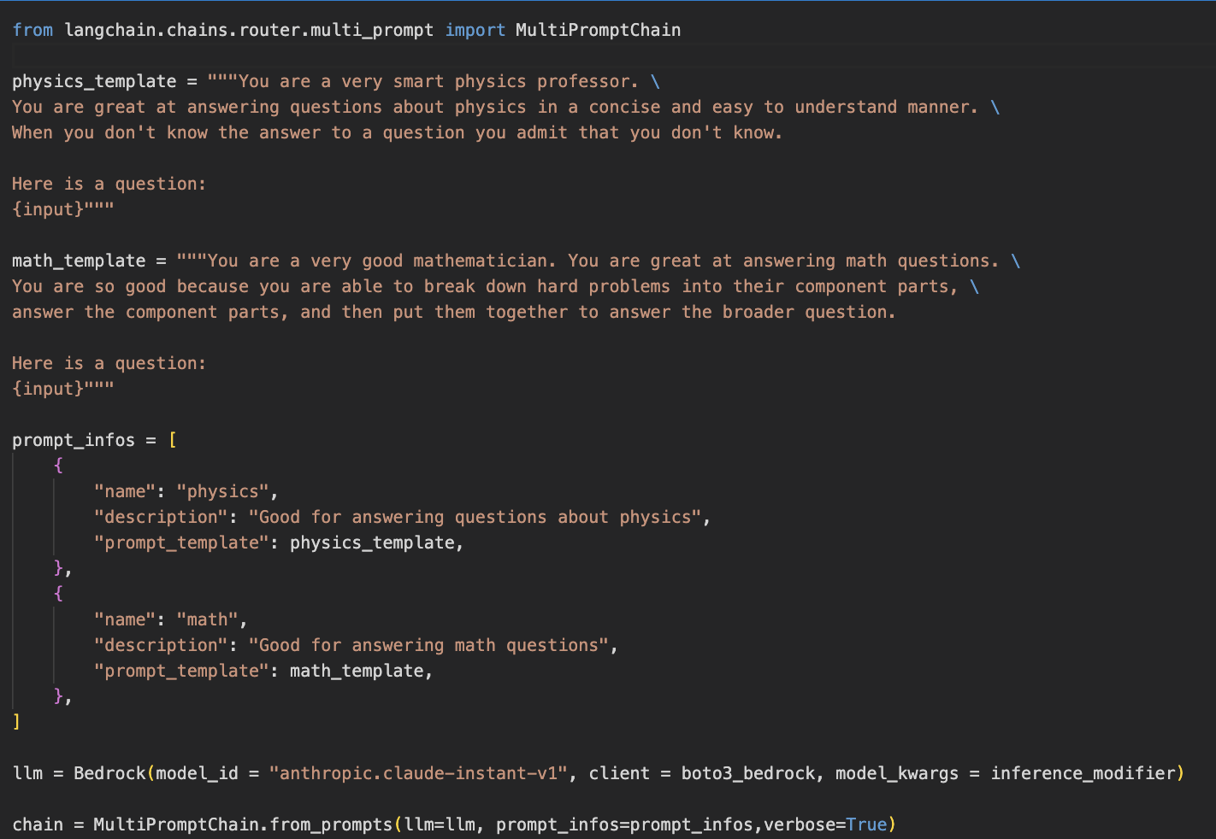
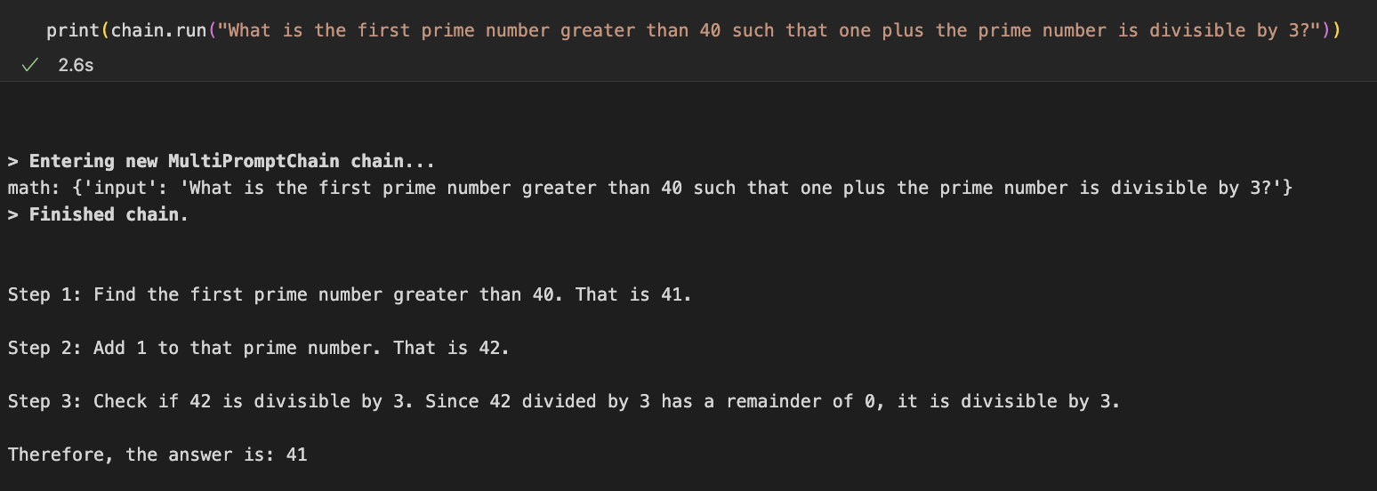
Multi-prompt chain
Note: Descriptions instruct the LLM which template to use!
chain.run(
"What is the first prime number greater than 40 such that one plus the prime number is divisible by 3?"
)

Slide 5
AWS Native LangChain Integrations
Use Amazon Bedrock foundation models – language and embedding models
Use Amazon SageMaker Endpoint as your LLM or embedding model
Have your LangChain agents leverage user defined AWS Lambda Functions
Utilize Amazon DynamoDB for your chat message history
Search Amazon OpenSearch Vector Storage for relevant knowledge to augment your LLM response
Build your own bespoke agent tools that leverage AWS!
Run your LangChain applications in your own VPC!
More to come!

Slide 6
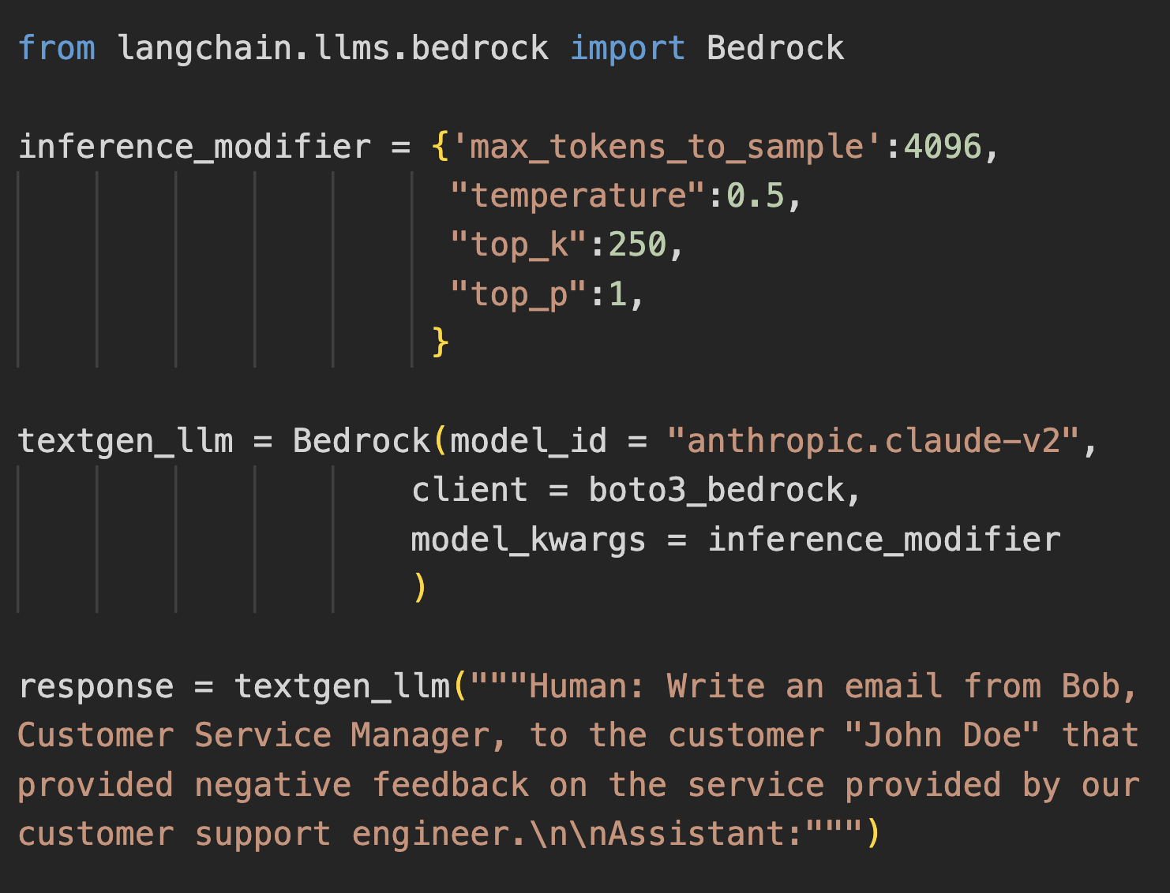
Amazon Bedrock integration
Amazon Bedrock is a fully managed service that makes foundation models (FMs) from Amazon and leading AI startups available through an API.
https://python.langchain.com/docs/integrations/llms/bedrock

Slide 7
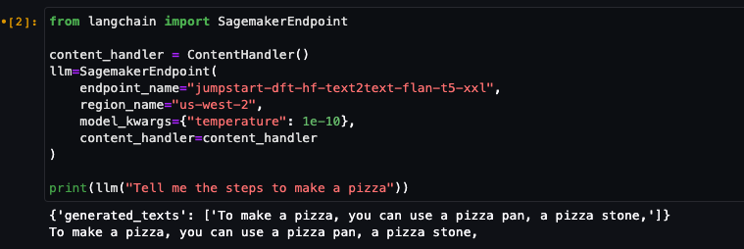
Amazon SageMaker Endpoints & SageMaker Embedding Endpoints
Composable applications can be built to leverage private connections to your own proprietary models hosted on SageMaker
Leverages boto3 sagemaker-runtime under the hood
Supports custom input/output handler functions

Slide 8
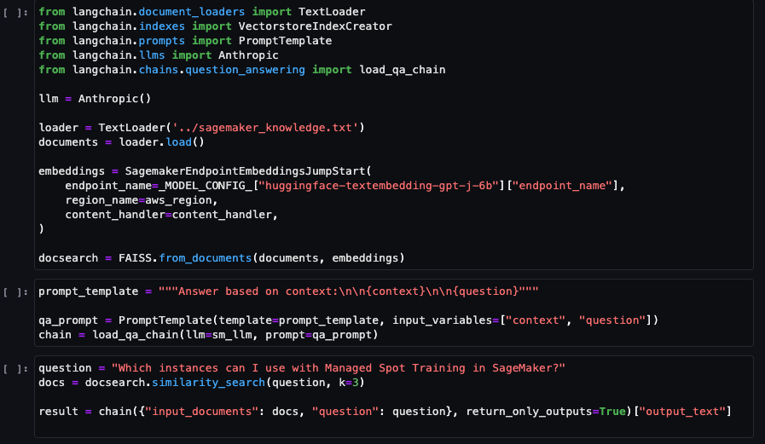
SageMaker Endpoint Example: Feed Context to your LLM
LLM Prompt contains
knowledge and user query

Slide 9
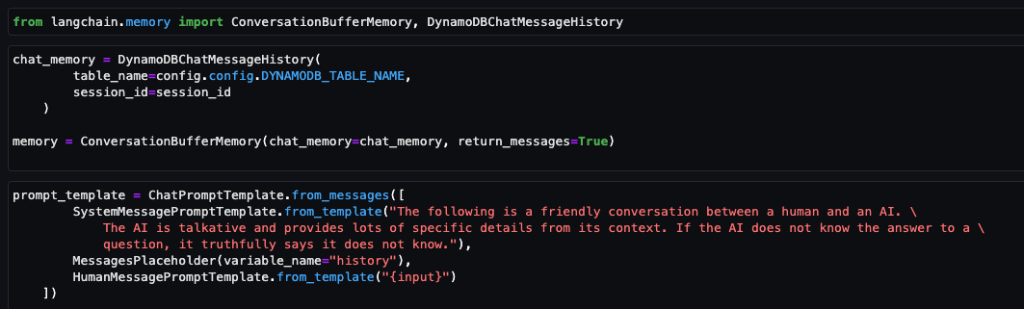
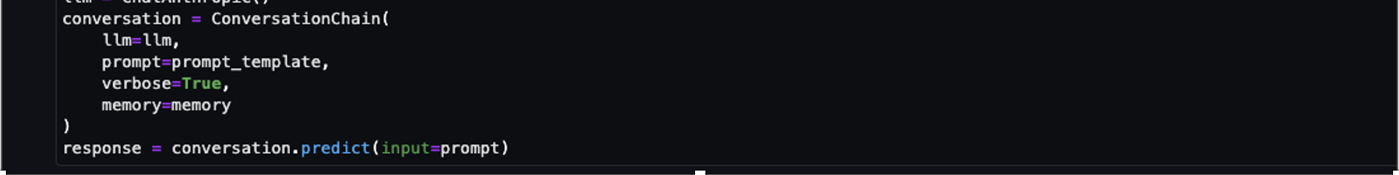
DynamoDBChatMessageHistory
Use Amazon DynamoDB to store persistent user messages for chat interfaces

Slide 10
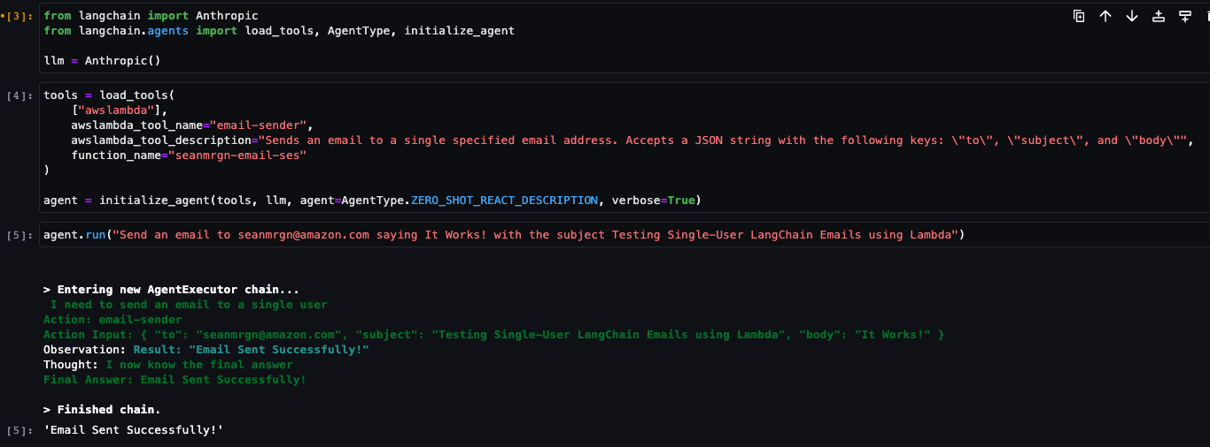
AWS Lambda integration with LangChain agents
Write natural language descriptions for AWS lambdas functions that agents can leverage
Existing AWS Lambda
xyz@example.com
LLM Generated Input

Slide 11

Demo
Understand architecture for retrieval augmented generation including demo with Amazon Bedrock and LangChain.

Slide 12




Question answering
With context
+
Small document
User question
Amazon Bedrock
foundation model
Generated answer
Prompt

Slide 13




Question answering
With Retrieval-augmented generation
1
3
Question + context
Amazon Bedrock foundation model
Answer
User
Context
Relevancy model: Amazon Titan Embeddings
2
Knowledge base
Document store
FAQs, Wiki …
New data
Vector DB
Amazon Titan Embeddings

Slide 14
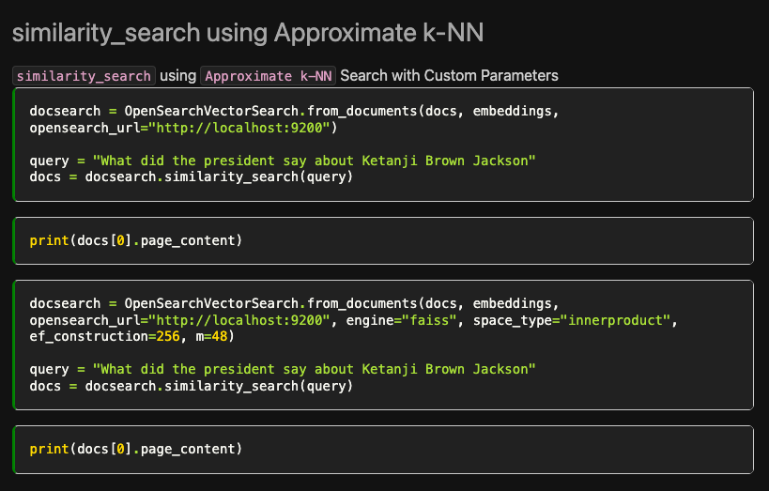
OpenSearch Vector Store
Use OpenSearch Vector Store to easily store and search your proprietary knowledge database to augment LLM responses

Slide 15
Resources
LangChain GitHub
Amazon Bedrock github including text summarization, chatbot and retrieval augmented generation (RAG) examples
Question answering using Retrieval Augmented Generation with foundation models in Amazon SageMaker JumpStart
Example LangChain Deployment Templates

Slide 16

Scan for slides

Slide 17
Mani Khanuja
https://www.linkedin.com/in/manikhanuja/
Notes:
Slide for c-suite
We have a lot more coming and are so excited for what you will build with generative AI on AWS. Our mission is to make it possible for developers of all skill levels and for organizations of all sizes to innovate using generative AI. This is just the beginning of what we believe will be the next wave of machine learning powering new possibilities for you.

Slide 18
LLMs vs. ChatModels

Slide 19
Agents
ReAct

Slide 20
Debugging Chains

Slide 21
Memory

Slide 22
AWS Authentication

